Slide 1

Probabilistic Generative Models

Slide 2
Introduction
What are generative models?
Key idea: Model joint distribution P(x,y)
Examples: Naive Bayes, Gaussian Mixture Models, LDA
Generative vs Discriminative
Discriminative Generative
Models ( P(y | x) )
Focus on decision boundaries
Understand data distribution
Ex: Logistic Regression | Ex: Naive Bayes

Slide 3
Why Generative Models?
Can generate new data
Useful for unsupervised learning
Useful for dealing with missing data
Probabilistic foundation
Basic Formulation
P(x,y)=P(x∣y)P(y)
Train using:
P(y)P(y)P(y): prior distribution over classes
P(x∣y)P(x|y)P(x∣y): class-conditional distribution

Slide 4
Bayes Classifier (from Generative Models)
Predict:
y∗=arg⁡max⁡yP(y∣x)=arg⁡max⁡yP(x∣y)P(y)P(x)
Bayes’ rule used to compute P(y∣x)P(y|x)P(y∣x)
Naive Bayes Classifier
Assumes features are conditionally independent given the class
Formula:
P(x∣y)=∏i=1nP(xi∣y)P(x|y)Simple, fast, effective

Slide 5
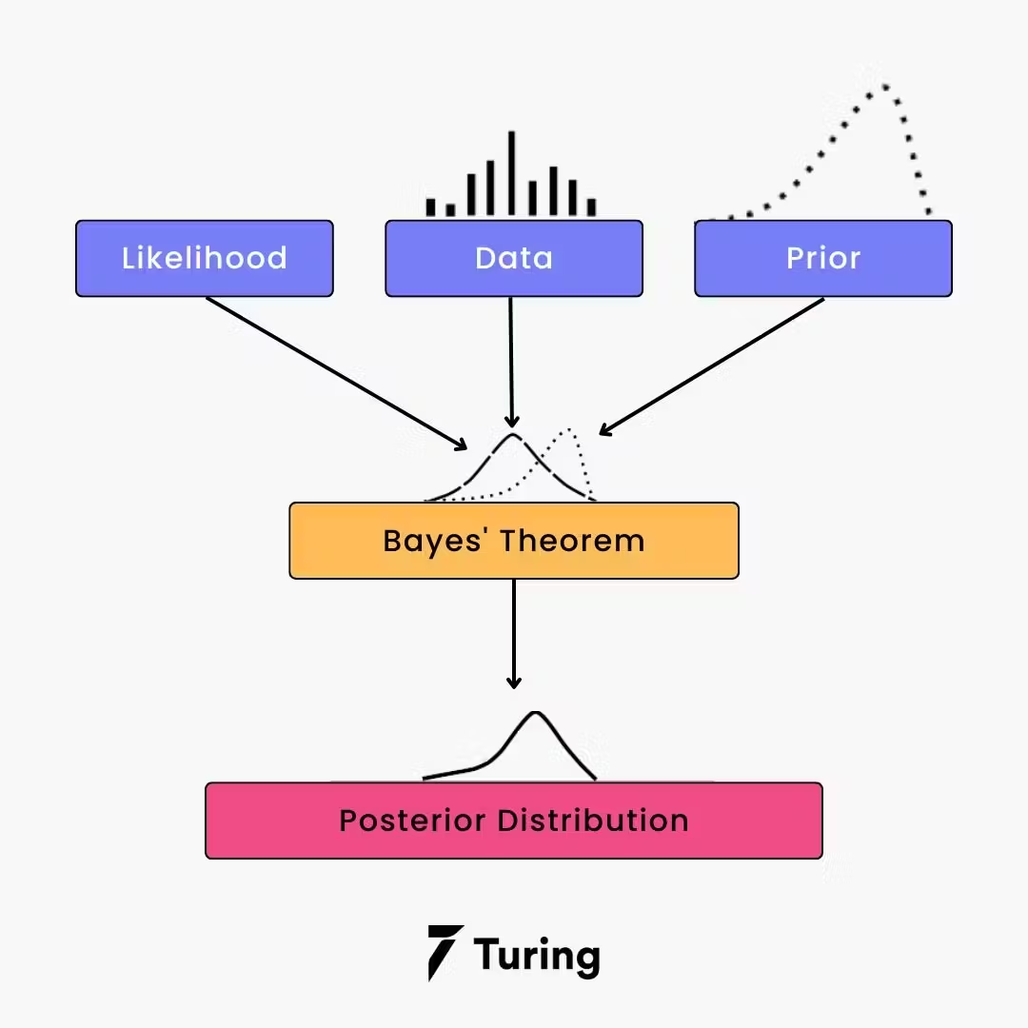
Naive Bayes – Diagram
Diagram: Naive Bayes graphical model (Y → X1,X2,...,XnX_1, X_2, ..., X_nX1​,X2​,...,Xn​)

Slide 6
Gaussian Generative Model
Assumes P(x∣y)∼N(μy,Σy)
Can derive Linear or Quadratic Discriminant Analysis (LDA/QDA)
Linear Discriminant Analysis (LDA)
Same covariance for all classes
Decision boundary: linear
Probabilistic interpretation with multivariate Gaussians

Slide 7
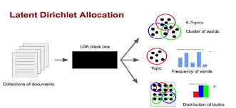
LDA – Diagram
Diagram: Show LDA separating 2D Gaussian blobs with linear boundary

Slide 8
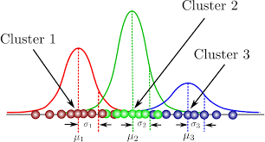
Gaussian Mixture Models (GMMs)
Unsupervised generative model
P(x)=∑k=1KπkN(x∣μk,Σk)Soft clustering: each point assigned a probability for each cluster
GMM – Diagram
Diagram: GMM clustering result in 2D space
Show overlapping Gaussians with ellipses

Slide 9
Learning with GMM – Expectation-Maximization (EM)
EM algorithm to estimate parameters
E-step: compute responsibilities
M-step: update means, covariances, and mixing coefficients
Latent Variable Models
Hidden variables explain data
Generative models with latent structure
Examples: LDA, GMM, Variational Autoencoders

Slide 10
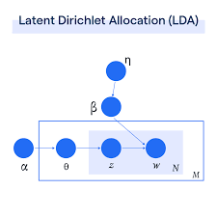
Latent Dirichlet Allocation (LDA - topic model)
Documents = mixture of topics
Topics = distribution over words
Useful in NLP
Diagram – Latent Dirichlet Allocation
Diagram: Plate notation showing words, topics, document structure

Slide 11
Applications of Generative Models
Text classification (Naive Bayes)
Anomaly detection (GMM)
Speech and image generation (VAEs, GANs)
Medical diagnosis
Summary
Generative models model P(x,y)
Can be used for both classification and generation
Examples: Naive Bayes, LDA, GMM
EM is a key algorithm for learning

